Slide 1




Slide 2



Slide 3


Slide 4



Slide 5

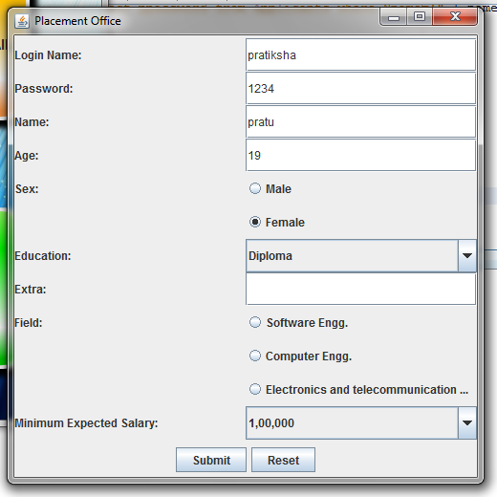

Slide 6




Congrats!
Best wishes for your future.

Slide 7



Login
Reset
Add
USERNAME:
PASSWORD:

Slide 9


Slide 10





Slide 11


Slide 12


Slide 13


